Slide 1
Computer Storage and Memory
Josiah McCarthy, Justin Davis, Braeden Winders, Zach Johnson

Slide 2
Introduction
How does a computer “know” something?
Computers store information for use in executing processes
How is it stored?
Long term storage
Hard drive
Flash drive
Floppy disk
Short term storage
RAM (Random Access Memory)
ROM (Read Only Memory)
Notes:
<JUSTIN>

Slide 3
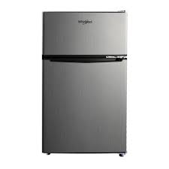
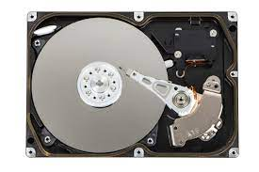
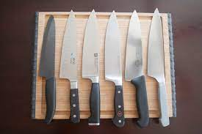
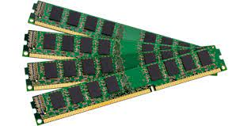
Analogy Time!
Let’s think of RAM as a kitchen countertop. To prepare dishes (programs), the chef (CPU) does all their work on the countertop, with produce (data) taken out of the fridge (storage). If there’s enough room on the countertop, the chef can comfortably work on multiple dishes at once.
The storage capacity of the fridge (storage) has nothing to do with the amount of counter space (RAM). \you can have the world’s largest fridge, and a cutting board for a counter. But you must have some counter space (RAM) to make your dishes (programs)
Notes:
<JUSTIN>

Slide 4
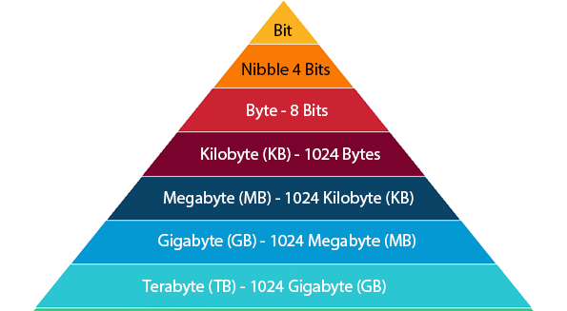
What is Memory?
Computer memory is a device or system used to store data for immediate use in a computer. It stores program instructions for the CPU (Central Processing Unit) to execute.
Memory does not permanently save data to the computer, it only saves it for immediate use while the computer is in use.
Memory is stored in bytes.
What is a Byte?
A byte is a collection of 8 bits (a 1 or 0). Data of various kinds, such as numbers and characters, are encoded as a series of bytes. A small number such as 3 can be stored as a single byte.
To store a number that cannot fit into a single byte, the computer uses several bytes.
What is Storage?
Storage is where permanent data is stored on the device and where data remains on the computer even when it has stopped receiving power.
Storage is in charge of making sure data is saved and ready to use for whenever it is needed.
Notes:
Braeden

Slide 5
Storage
Memory
V/S
Majority of physical permanent storage mediums.
Is saved for later use in the computer.
Non-volatile, information is stored on these mediums even if there is no power
Hard Drive Disk (HDD)
Compact Disk (CD)
Flash Drive
SD Card
Micro SD card
Programs use memory in order to function.
When Memory is too low, there are too many programs taking up a system’s memory.
Is saved temporarily for immediate use.
Volatile, information is lost if machine loses power
Notes:
Braeden

Slide 6
Types of Computer Memory
Primary Memory -
RAM - Random Access Memory
“Short term” memory for a computer
Goes away if computer loses power or is turned off
When data gets transferred to RAM, its known as “loading”
Hardware and software
ROM - Read Only Memory
Semi/Permanent memory containing important instructions
programs /Instructions are fully embedded in ROM chips
Hardware and non-volatile Software
Secondary Memory -
Flash
non-volatile
Found in flash drives, solid state drives,
Collection of bits in Flash memory are stored in cells
Notes:
<JUSTIN>

Slide 7
Random Access Memory (RAM)
DRAM
Most common RAM used in computers, standing for Dynamic RAM
Oldest type is called single data rate DRAM, while newer computers use dual rate data DRAM.
Dual rate data has had different versions that gradually have improved efficiency with the DRAM.
Consists of a transistor and capacitor in each cell. Transistors are like switches, capacitors are like storage units that slowly leak, so they must be refreshed.
SRAM
Much faster, bulkier, and more expensive than DRAM, standing for Static RAM
SRAM is mostly used for high end server systems, with each cell containing six transistors instead of one.
Since SRAM does not use capacitors, it does not need to be refreshed.
Notes:
Josiah

Slide 8
Read Only Memory (ROM)
Compared to RAM, Read Only Memory will retain information even when it is not receiving power.
When memory persists when it is not receiving power, it is called “non-volatile”
PROM
Programmable Read Only Memory is a type of ROM that does not have a process written during its manufacturing. PROM is manufactured in an empty state so it can be used from scratch.
EPROM
Erasable Programmable Read Only Memory is just like PROM, however as the name suggests, the programming on it can be erased and the user can start over with a new program. EPROM can only be erased physically, so it must be removed from the computer in order to be changed.
EEPROM
Electronically Erasable Programmable Read Only Memory is just like EPROM, however it’s programming can be erased while still in the computer system it is installed in. Because of this, EEPROM is technically not “read only” since it can be written in.
Examples can be printer systems or startup programs on a computer.
Notes:
Josiah

Slide 9
Flash Memory
Flash memory stores bits of information in cells.
The whole cell must be copied, changed, and rewritten every time even a single bit is changed.
Flash memory can deteriorate over time.
It is the cheapest and most compact form of data storage today.
Notes:
Braeden

Slide 10
How does Storage Work?
Storage Remains intact while it does not receive power, it will only be deleted if it is deleted manually.
Storage devices can be magnetic, optical, flash, or virtual.
Storage is much slower than memory since it is saved to be used for later use.
Whenever something from storage is needed, it is retrieved for use, then put back into the background of the device.
Data in storage is retrieved by an “address” that is given to all data in storage. This address is the “location” of the data in storage.
Notes:
Josiah

Slide 11
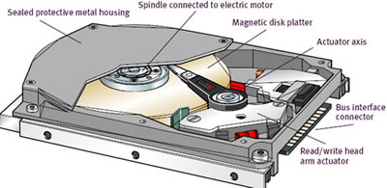
Types of Computer Storage
Hard Drive Disk (HDD)
Provides a large storage capacity
Primary media for storing data and programs
Characterized by data read and write speeds
In terms of mechanical hard drives, they are classified by how many times per second the internal disk rotates
Compact Disk (CD)
3 Types
Compact Disk - Recordable (CD-R)
Can only be written once and can not be erased
Compact Disk-Read Only Memory (CD-ROM)
Only able to read once.
Once read, it is used as a ROM which cannot be updated later
Compact Disc - Rewritable (CD-RW)
Can be written multiple times and can be erased also
Notes:
Zach

Slide 12
Types of storage cont.
Flash storage devices
Flash drive
There are not a single moving part in this device.
The data storage is done using non-volatile semiconductor flash memory chips
Uses less power than a hard disk drive
SD/microSD card
Originally for cameras
convenient size
Modern cards can store up to a Terabyte
Used in phones

